Slide 1

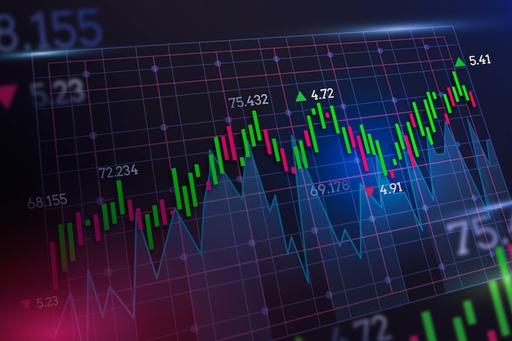


SMART TRADER
FOLLOW ME

